Slide 1


Visual Analytics: European Dataset
Group U7:
Ellis Thompson, <ADD Names Here>

Slide 2
Motivation
Europe, namely ancient Greece, is considered the birthplace of western civilisation
A dataset which allows the analysis of modern Europe
A way to compare perceived statistics across Europe

Slide 3

The Data Set
European political dataset with stats on:
Crime
Environment
GDP and Income
Health
Satisfaction
Trust in government sectors
Datasets range in years 2011-2016
Datasets have a range but have been grouped for visualisations
Prevents cross contamination and inaccurate conclusions
https://www.kaggle.com/roshansharma/europe-datasets

Slide 4
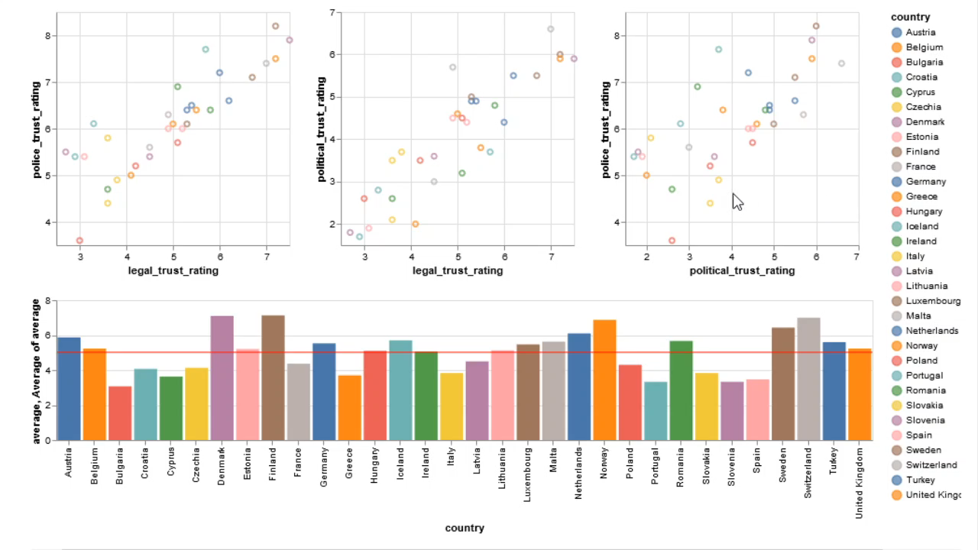
Trust Graphs
Focuses on the three trust ratings available
Police
Political
Legal
All data from 2013
Shows a positive

Slide 5
Conclusion
We can conclude that the dataset is relative to the country
We believe that each participant was rating relative to their country not other European countries.

